Slide 1


MYSURU ROYAL INSTITUTE OF TECHNOLOGY (Affiliated to VTU, Belagavi, Approved by AICTE, New Delhi & Govt. of Karnataka) Lakshmipura Road, Off-Mysuru-Bengaluru Highway, Srirangapatna
DEPARTMENT OF COMPUTER SCIENCE AND ENGINEERING
Project Presentation on
Vision Rehabilitation Assistance Device
For Visually Impaired Individual
Under the Supervision Of
By,
Internal Guide
Dr. Lokesh M R
Professor
Dept of CSE, MRIT
Ankith G(4MU15CS004)
Dhananjaya G (4MU15CS015)
Maheshwara S J (4MU15CS033)
Musthahid Ahmed (4MU15CS038)

Slide 2
Contents
AIM
Objective
Existing System
Problem Statement
Problem solution
Architecture
Process Sequence
Software and Hardware
Implementation
Result Discussion
Conclusion
References

Slide 3
Aim

Slide 4
Aim
This project aims at making the life of blind people easy.
This is a camera-based application in which the Quick Response Code (QR Code) is used to read the description of the product details which is located in the cloud.
With the help of speech synthesizer, the application understands the product’s name.
The application also built with a unique code to help in navigate and obstacle identification using mapbox & Ultrasonic sensor .
The main aim of the application being developed is to enable the blind people to distinguish between packaged and other goods.
Therefore, this application benefits the visually challenged people and ease the identifying products.

Slide 5
Objective

Slide 6



Objective
According to a recent survey by a “National Organization for Eye Doctors”
India accounts for 20 percent of the total blind population of the world
So our main aim is that make those peoples life better.
Not only for visually challenged peoples
but also
this system is useful for (usual/ commonly and regular/ healthy) people
because system recommends the best alternate product.

Slide 7
Problem Statement

Slide 8


Problem Statement
Because of these problems visually impaired people feel they are dependent
Is to be independent
The main goal of visually impaired people
Identifying products and their details
Due to certain glitches they face many issues such as:
Navigating from one place to another to find the products .

Slide 9
Existing System

Slide 10
Existing System
In [7] “Virtual-Blind-Road Following Based Wearable Navigation Device for Blind People,”
The paper provides module utilizes that the RGB image and the depth image to build the virtual-blind-road (offline) and locate the user (online). After the virtual-blind-road is tagged with some key positions (offline), it becomes a sparse map (i.e. PoI-graph). the virtual-blind-road is built, the PoI-graph will be generated through tagging some PoI such as rooms, toilet, bar, hallway junctions as the nodes on the virtual-blind-road. The edge connecting two nodes in PoI-graph has a weight equal to the real distance between the nodes.
1. Building the virtual-blind-road.
2. Locating the user.
3. Obstacle distance measured by the ultrasonic rangefinder.
In [8] “Voice Operated Outdoor Navigation System for Visually Impaired Persons”
The Paper Describes The 32-bit ARM processor (LPC2148), this is the heart of this project. The LPC2148 microcontrollers are based on a 16-bit/32-bit ARM7TDMI-S CPU with real-time emulation and embedded trace support, that combine microcontroller with embedded high-speed flash memory ranging from 32 kB to 512 kB. A 128-bit wide memory interface and unique accelerator architecture enable 32-bit code execution at the maximum clock rate.
In [] “Smart guiding glasses for visually impaired people in indoor environment”
The Paper Provides Navigation for the blind in indoor environment should consider the problems of localization, way-finding, route following and obstacle detecting. Many ETAs were reviewed in details [5], which utilize ultrasonic, laser scan, camera or multi-sensor fusion technology for obstacle detecting and/or avoiding.

Slide 11
Problem Solution

Slide 12
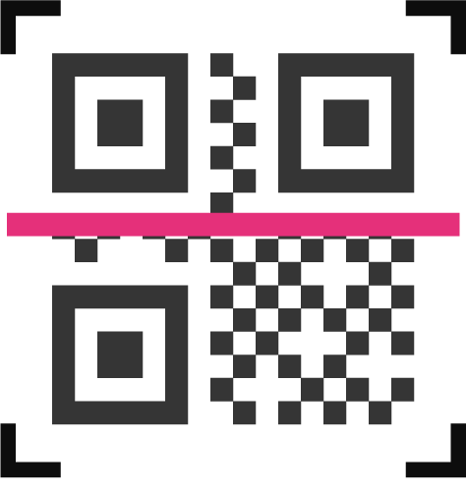
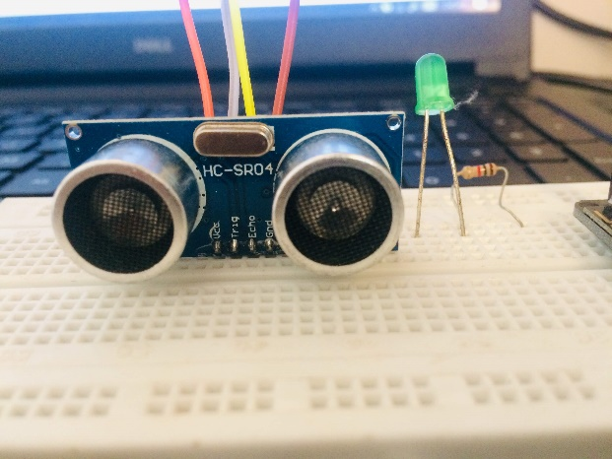

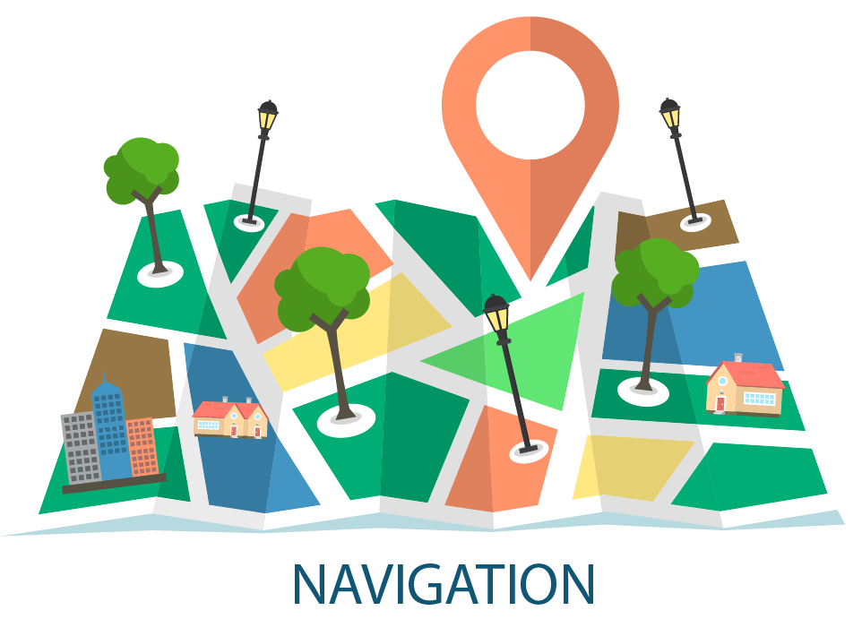
Vision Rehabilitation Assistance Device Consists of 3 Main Module:
Blind Assistive device using Ultrasonic Sensor.
Product Identification using QR-Code
Outdoor Navigation System for Blind Pedestrians Using GPS.
3
1
2

Slide 13
Architecture

Slide 14
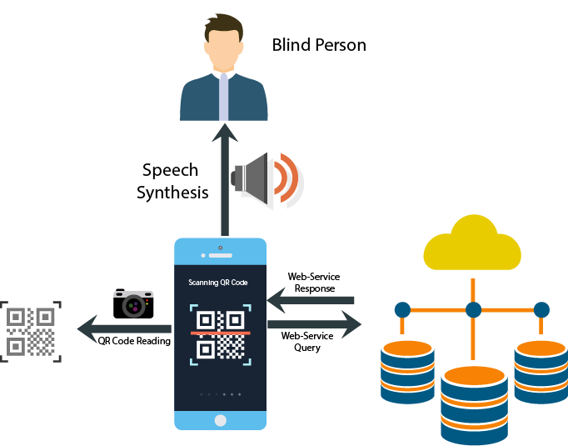
High level Design
Product Identification using QR-Code:

Slide 15
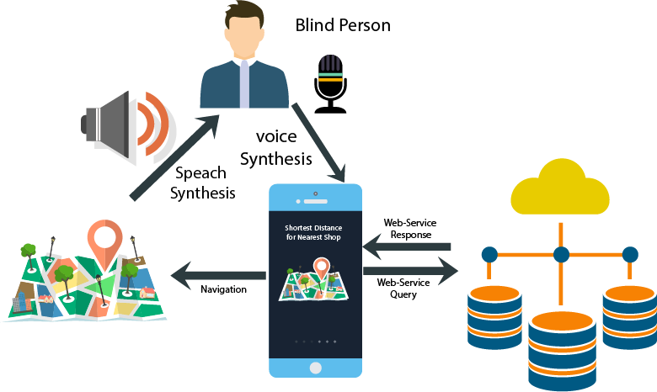
Outdoor Navigation System for Blind Pedestrians Using GPS

Slide 16
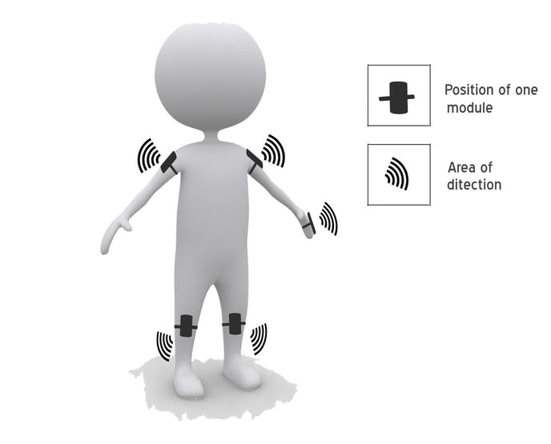
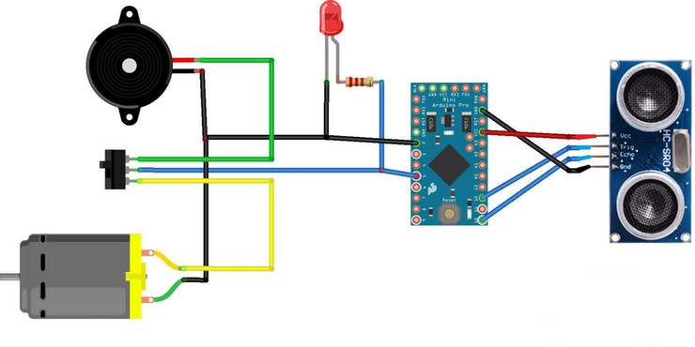
Outdoor Navigation System for Blind Pedestrians Using GPS

Slide 17
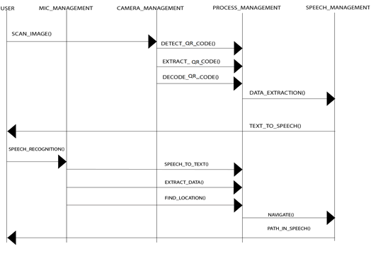
Low Level Design

Slide 18
Requirements

Slide 19


Requirements
01
User Requirements
1.Easy to understand and should be simple.
2.Better User Interface.
3.Comfortable to use.
02
Software Requirement
Windows
Browser.
MySQL
Visual Studio.
Android Studio
Arduino IDE
03
Hardware Requirement
1.Processor- Intel
2.RAM- 2GB
3.Arduino Nano
4.Ultrasonic Sensor
5.Vibrator Motion

Slide 20
Control
Flow

Slide 21
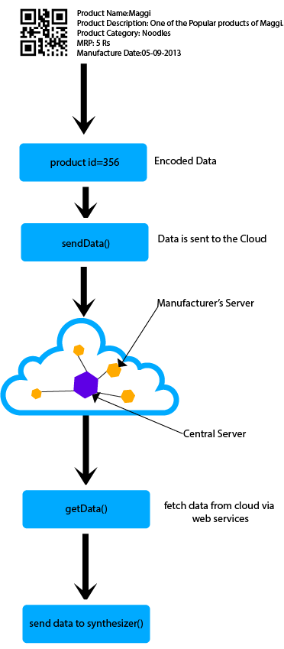
Process Sequence
Using the smartphone’s internet connectivity, the user’s geospatial information is transmitted to a cloud server as a data sentence.
Upon reception, the server constructs a text file containing longitude, latitude, and orientation and discards other information, such as time, altitude, number of satellites, etc.
we can see the process sequence of a QRCode Extraction and Speech Synthesizer.
QRCode can be detected quicker than text and it can store huge amount of data in a small 2D space.
QRCode is decoded by the application and after decoding of the product details, its feed to Speech Synthesizer for the conversion of text data into speech, hence via Speech the visually Impaired Individual can know the product details mainly the expire date.

Slide 22
Implementation

Slide 23
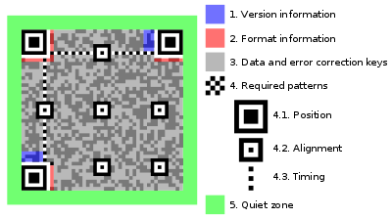
Implementation
The various steps involved in the process of Identifying product and Outdoor navigation for A product are as follows:
1.The pseudo code for the proposed mode l is shown below.
decode()
{
if ( image == QRcode)
{
decode the code and get the data;
}
else
return decoding Failed;
}
senddecoded()
{
Store the decoded data in a buffer send through web services;
if (sending == success)
return sending success
else
return sending failed
}
synthesizer(data)
{
synthesize the data and convert to speech;
return speech to the speaker;
}

Slide 24
Continued..
2.The pseudo code for the proposed mode 2 is shown below.
geocode(){
/*map latitude and longitude from google api using
The JSON provided by google api*/
return latitude and longitude;
}
navigate(){
//navigate to the shop via speech();
}
synthesizer(speech){
Synthesize the speech and convert to text;
Return text;
//returned text(Product Name) to the cloud
}
senddata(){
/*categorize the product and find the nearest shop or
mart*/
for(all shop having the product){
latList=getlat();
lonList=getlon();
//from geocode();
}
Dijkstras(vector);
return the shortest distance;
//from the user current location;
}

Slide 25
Result Discussion

Slide 26
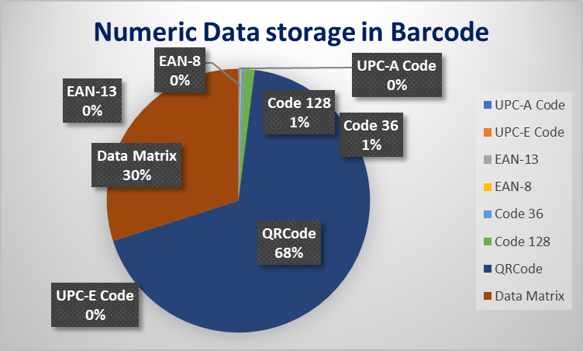
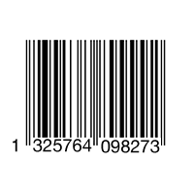
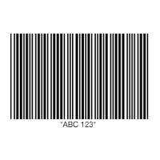
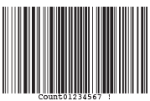
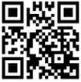
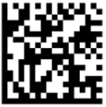
Result Discussion
Identification the product
Table 9.1 Comparison between all the types of barcode with their meta data
Sl.no | Barcode Type | Barcode Name | Image | Variation | data storage
1 | 1D | UPC CODE |  | UPC-A & UPC-E | 12 numerical & 6 numerical digits
2 | 1D | EAN CODE |  | EAN-13, EAN-8, JAN-13 | EAN-13 (13 digits) & EAN-8 (eight digits)
3 | 1D | CODE 39 |  |  | 39 characters
4 | 1D | CODE 128 |  |  | 128 characters
5 | 2D | QRCode |  |  | 7089 Numeric, 4296 Alphanumeric
6 | 2D | Data matrix |  |  | 3116 Numeric, 2335 Alphanumeric
Figure 9.1 Numeric Data storage in Barcode

Slide 27
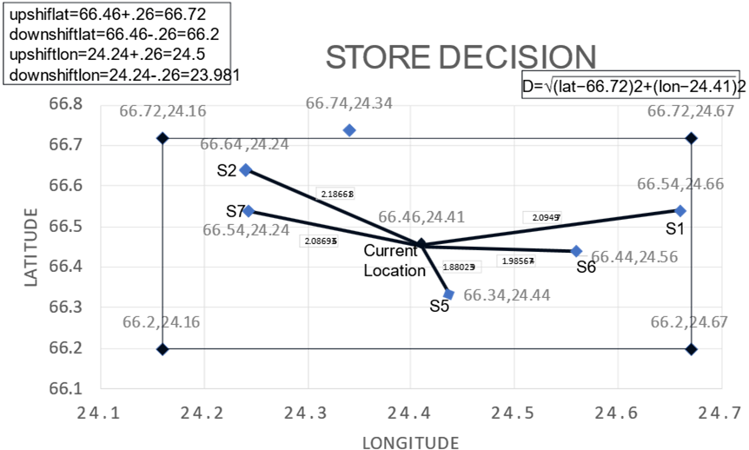
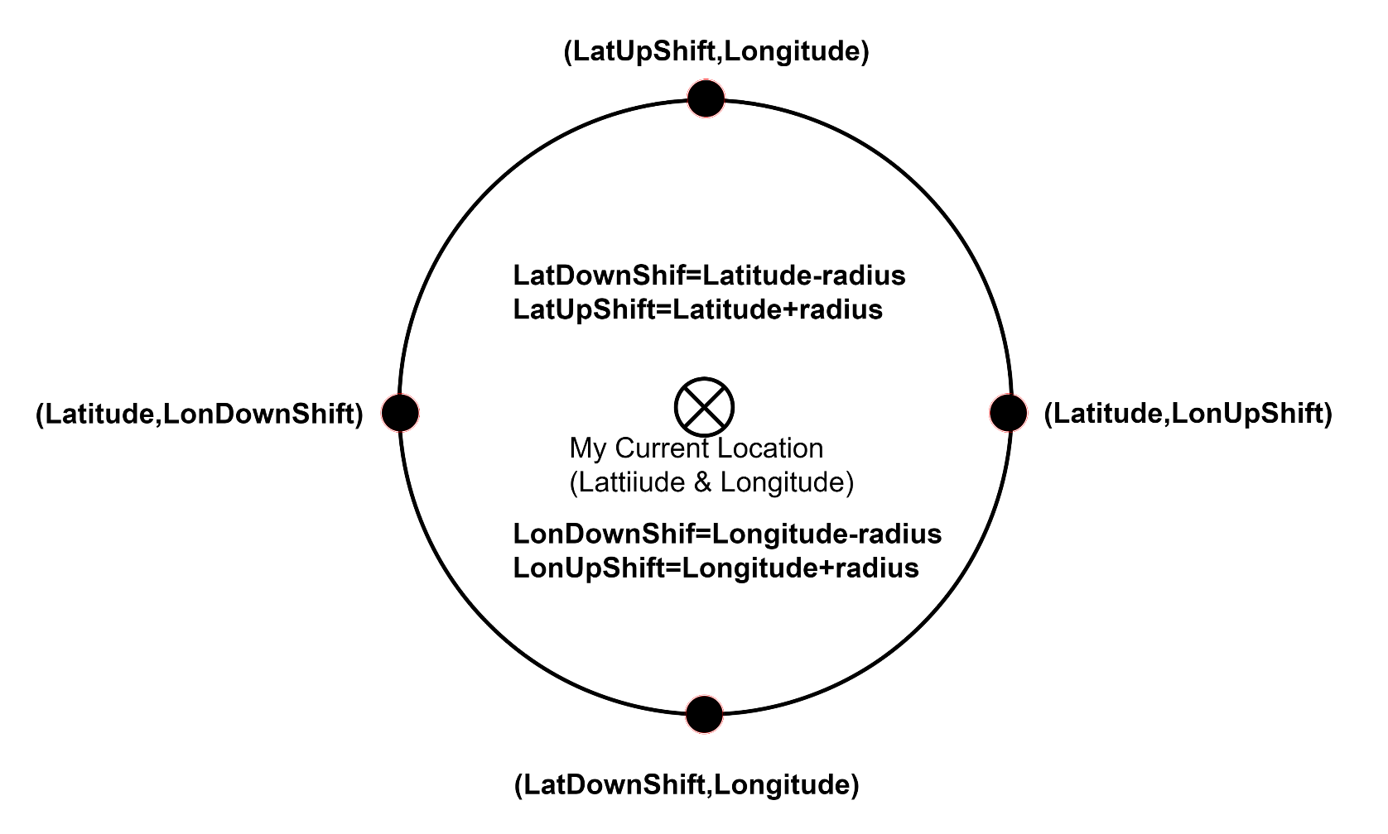
Continued…
Speak and search
Table 9.2 Store-Product Mapping Dataset Analyzed based on 3 parameters i.e., Expiry Date, Quantity and Distance between current location (66.46,24.41) and store location
Store id | Expiry Date | Quantity | Longitude | Latitude | Distance
s1 | 04-09-19 | 4 | 24.24 | 66.54 | 2.086936
s2 | 04-10-20 | 5 | 24.24 | 66.64 | 2.186618
s4 | 05-11-24 | 7 | 24.34 | 66.74 | 2.281074
s5 | 06-12-22 | 8 | 24.44 | 66.34 | 1.880239
s6 | 04-04-22 | 9 | 24.56 | 66.44 | 1.985674
s7 | 10-05-20 | 10 | 24.66 | 66.54 | 2.09497
Figure 9.3 Store Decision method by Euclidean distance and concept of upshift and downshift

Slide 28
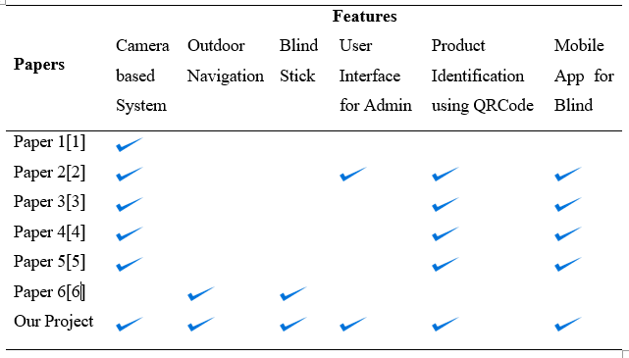
Continued…
The proposed environments and the paths followed by the test subjects are shown in below Figure. Both subjects successfully completed the task with no errors
Table 9.3 Comparison between Existing and Proposed system

Slide 29
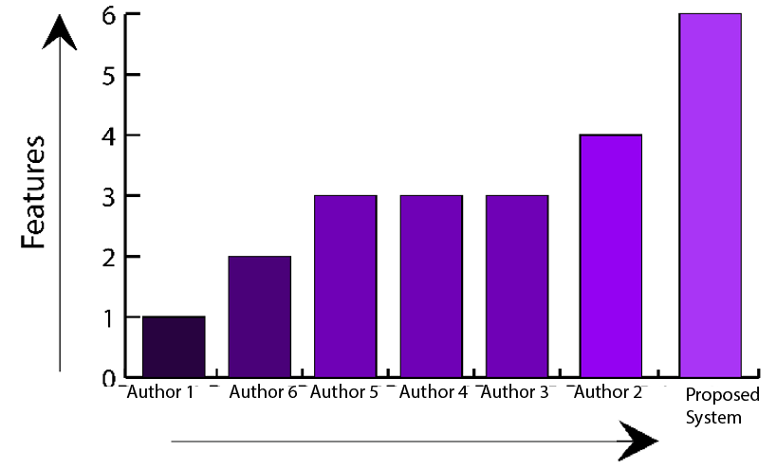
The Efficiency of our paper

Slide 30
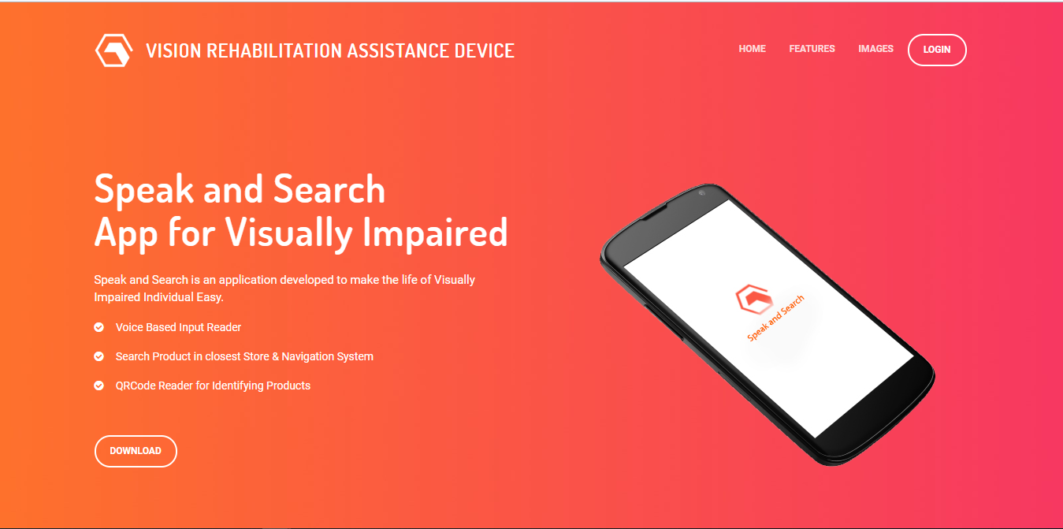
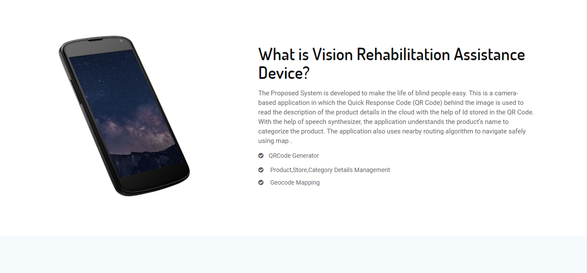
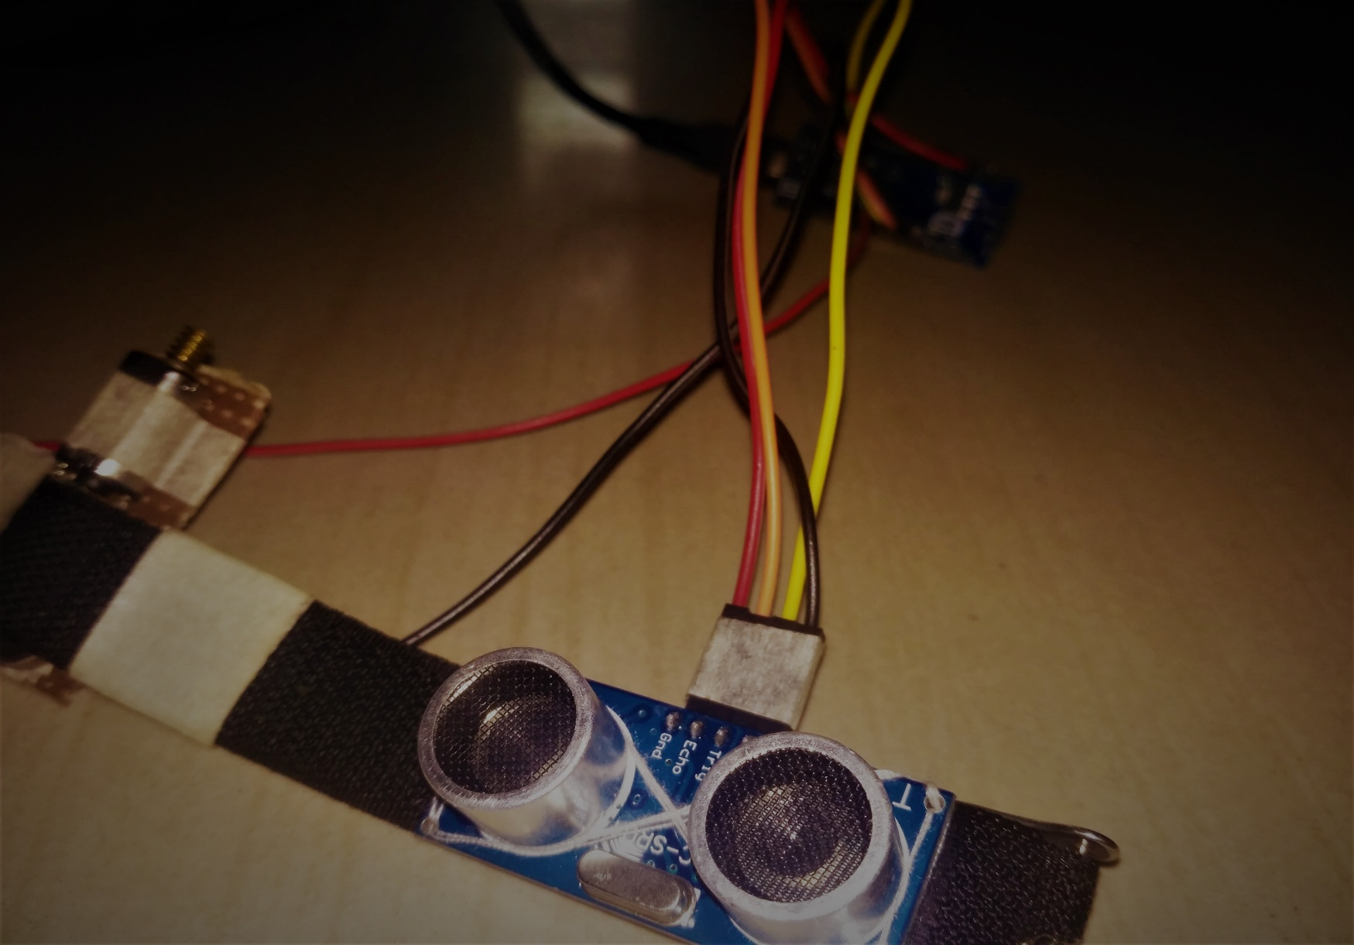
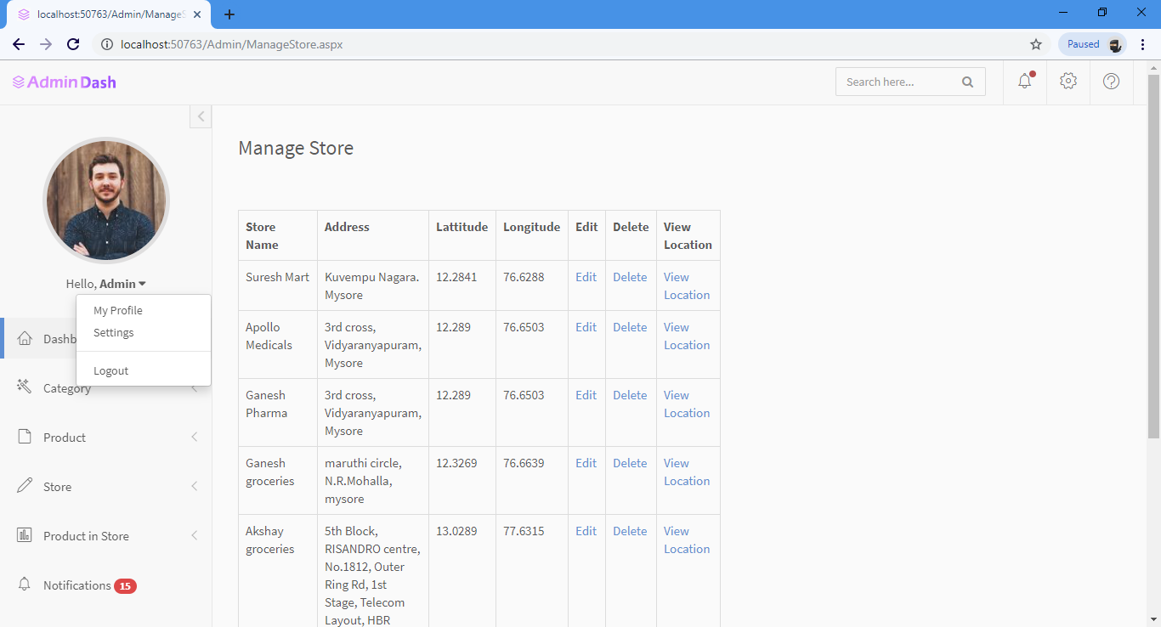
Snapshots

Slide 31
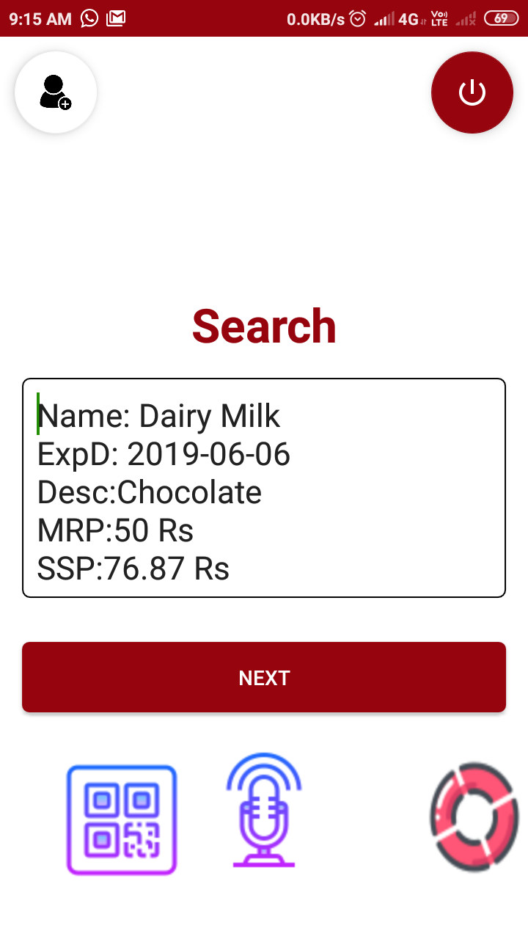
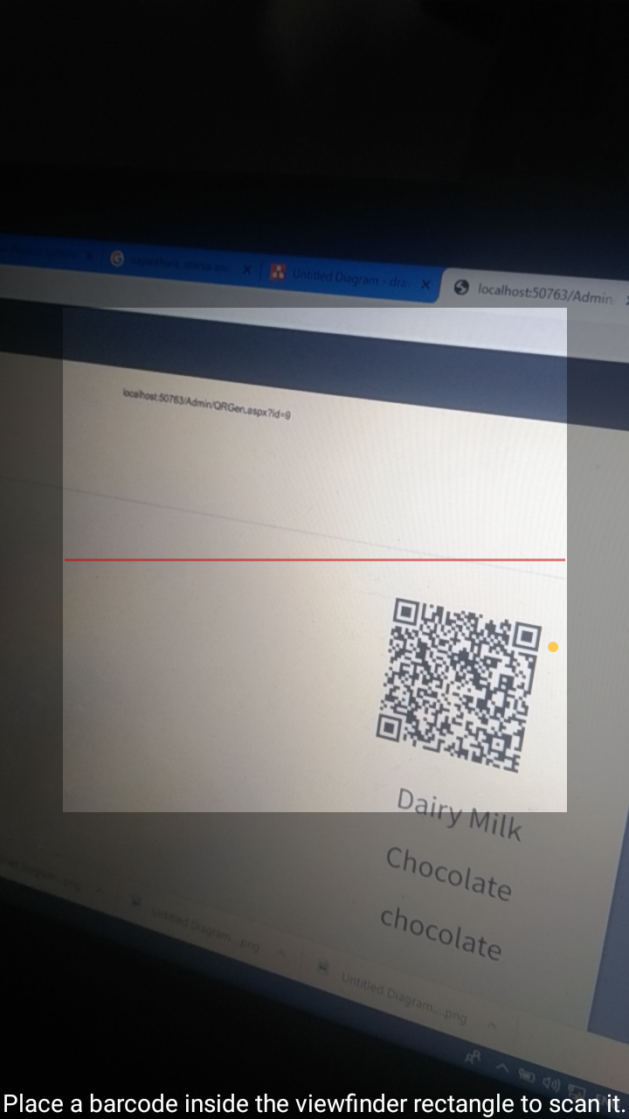
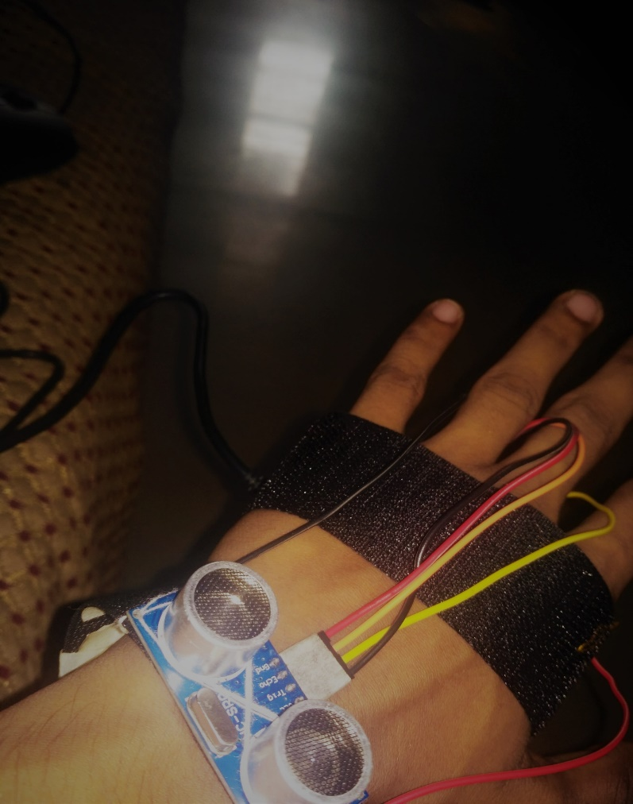
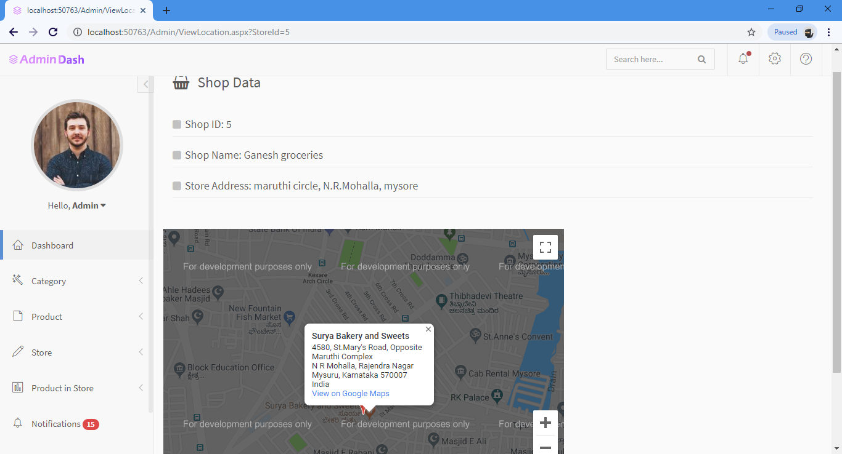
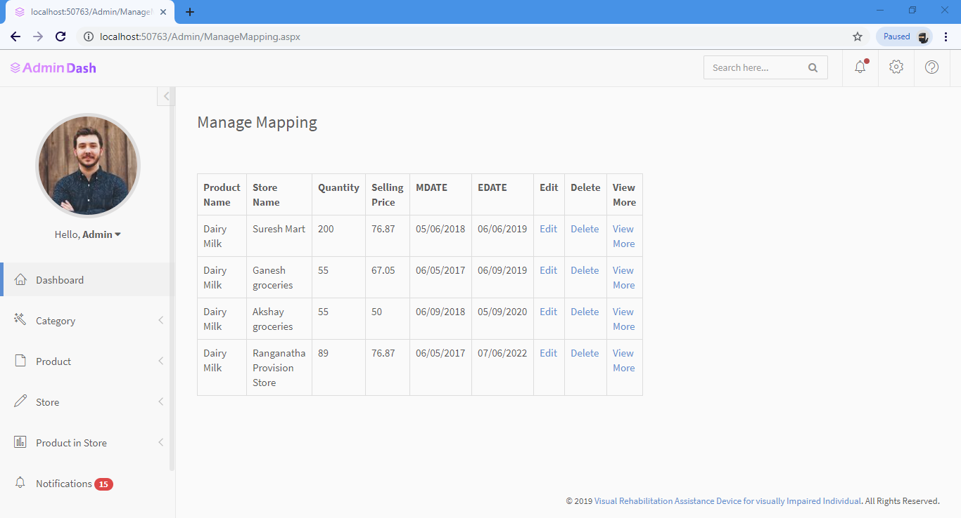
Snapshots

Slide 32
Conclusion

Slide 33
Conclusion
01
Experiments with blind/visually impaired volunteer participants demonstrate
the feasibility of Speak and Search, and suggest that its usability is significantly enhanced by real-time feedback to help the user find QRCode before they are read.
02
We classify all the products
which satisfy all the conditions such as only those stores which have the availability of required product, product in stores and stores which are near to the user’s current location by applying Upshift and Downshift to the Current location.
03
Contents
contents
04
Contents
Contents

Slide 34

Future Enhancement
Visually Impaired Individual May face many problems in Outdoor Navigation having health care monitoring system in the Module 4 of the Proposed Architecture would make it more efficient.
To make it much better many regression algorithms can be utilized and the quality of those unpacked items can be classified and detected by many technics and algorithms such as SVM, K-means and etc.
Making the Module 4 of the proposed system much better by making a suite which consists of ultrasonic sensor to detect the obstacle from all the direction to make the system as a 7th Sense for the Human.
With the current work we can conclude the system very efficient in restricted manner i.e., we mainly concentrate on packed Products and ignore the other items such as unpacked vegetables and fruits.

Slide 35
References
―Voice Assisted Navigation System for the Blind‖, by Ananth Noorithaya1, Kishore Kumar M, Dr. Sreedevi A, published in Proceedings of International Conference on Circuits, Communication, Control and Computing (I4C 2014).
"Mobile Blind Navigation System Using RFID‖, by RachidSammouda, Ahmad AlRjoub, published in IEEE 2015.
"AN ELECTRONIC WALKING STICK FORBLINDS", by ShashankChaurasia and K.V.N. Kavitha, published in ICICES 2014.
"New electronic cane for visually impaired people for obstacle detection and recognition", by Sonda AMMAR BOUHAMED, Jihen FRIKHA ELEUCH, published in 2012 IEEE International Conference on Vehicular Electronics and Safety July 24-27, 2012. Istanbul, Turkey
Smart device for visually impaired people,Kasthuri R, Nivetha B, Shabana N, Veluchamy M, Sivakumar S, IEEE 2018, https://doi.org/10.1109/ICONSTEM. 2018.8261257
Jinqiang Bai, Shiguo Lian, Member, IEEE, Zhaoxiang Liu, Kai Wang, Dijun Liu, “Virtual-Blind-Road Following Based Wearable Navigation Device for Blind People,” DOI 10.1109/TCE.2018.2812498, IEEE Transactions on Consumer Electronics.
Somnath koley, Ravi Mishra,” VOICE OPERATED OUTDOOR NAVIGATION SYSTEM FOR VISUALLY IMPAIRED PERSONS”, International Journal of Engineering Trends and Technology- Volume3Issue2- 2012
J. Bai, S. Lian, Z. Liu, K. Wang and D. Liu, “Smart guiding glasses for visually impaired people in indoor environment,” IEEE Trans. Consum. Electron., vol. 63, no. 3, pp. 258-266, Aug. 2017.

